Slide 1
OIL PRICE PREDICTION Group-3 Mentor: Karthik
Date :09/06/2023

Slide 2
Business Problem
Oil price may fluctuate time to time based on more factors technical economical and natural as well as political so the forecasting may not be influenced by these some unexpected scenarios like Geopolitical issues (e.g.: War and Oil price Cap)
Objective:
Oil is a product that goes completely in a different direction for a single market event as the oil prices are rarely based on real-time data, instead, it is driven by externalities making our attempt to forecast it even more challenging
As the economy will be highly affected by oil prices our model will help to understand the pattern in prices to help the customers and businesses to make smart decisions.

Slide 3
Factors affecting the oil prices
Changes in the value of the U.S. dollar
Changes in the policies of the Organization of Petroleum Exporting Countries (OPEC)
Changes in the levels of oil production and inventory
The health of the global economy , Population ,War, Natural calamities, Other unpredictable factors such as Medical emergencies like COVID-19 etc.
The implementation (or collapse) of international agreements
reference link: https://www.investopedia.com/articles/investing/102215/4-reasons-why-price-crude-oil-dropped.asp
Dataset source: Kaggle

Slide 4
Exploratory Data Analysis (EDA) and
Feature Engineering

Slide 5
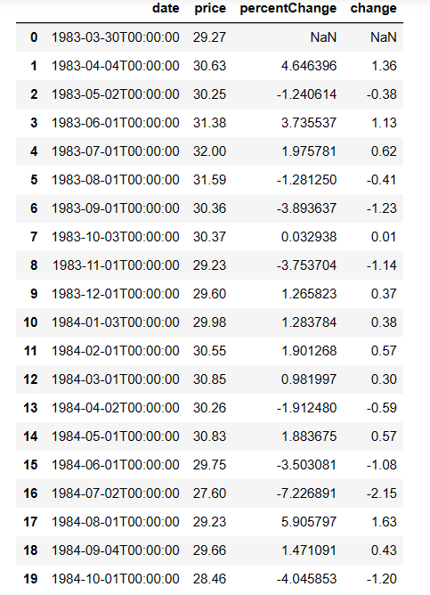
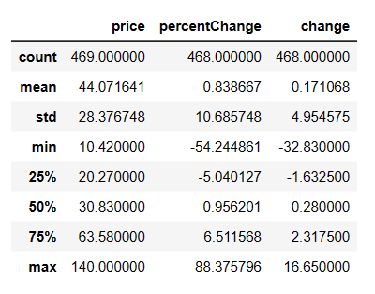
Data set details
Data set contains date column % change column and change column
Price in USD/BBL.
We need to forecast oil price so need only date and price column only for model creation.
Dataset overview:
Date range: March 1983 to March 2022
Number of data points: 469
Columns: Date, Price
Price statistics:
Average price: $44.071 USD/BBL
Median price: $30.83 USD/BBL
Skewness: Right-skewed (higher prices are Less frequent)
Outlier: One outlier exists in the dataset
Price variability:
Standard deviation: $28.37 USD/BBL
Minimum price: $10.42 USD/BBL
Maximum price: $140 USD/BBL

Slide 6
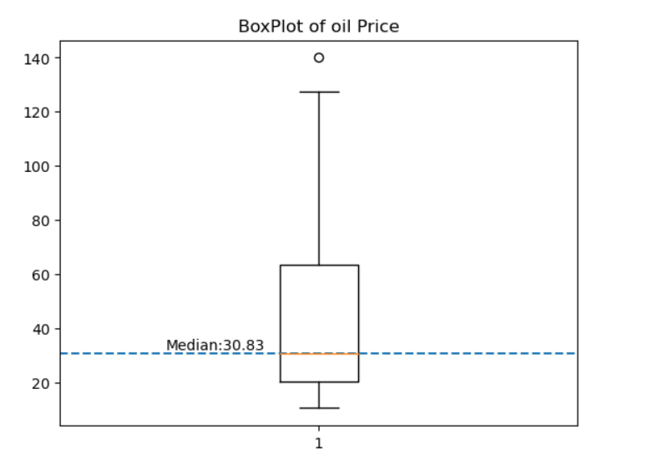
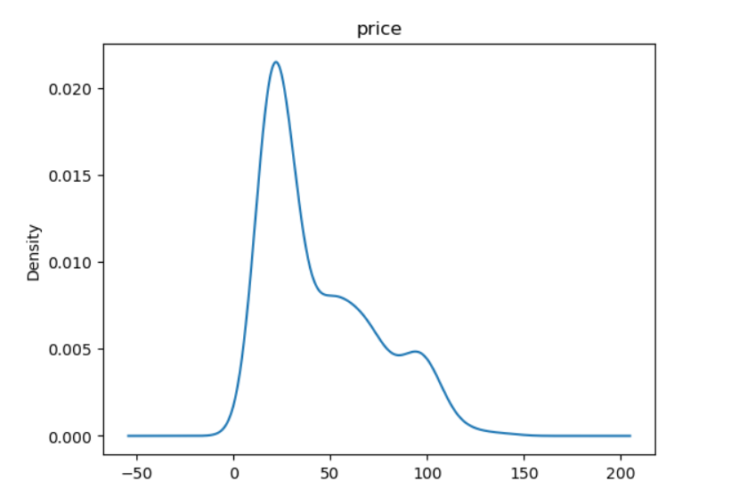
Distribution of price data
Data is right skewed
Median is 30.83
One outlier 140 which is max oil price recorded in the dataset.
Half of oil price data shows less than 30.83 USD/BBL and rest is high range from 30-140 .

Slide 7
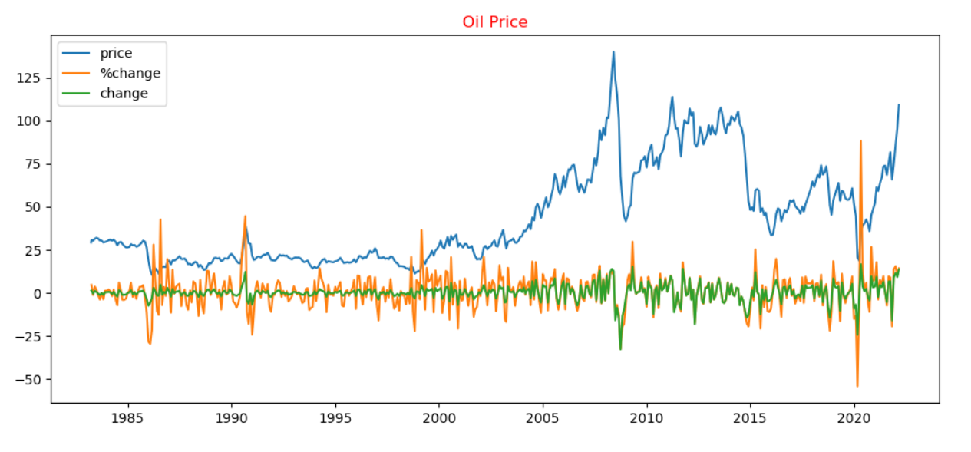
Visualizations
Oil price trend:
Since the early 2000s, the price of oil has generally been going up.
It reached its highest point in 2008 but dropped significantly during the global recession.
After 2008, the price started to rise again, especially from 2010 onwards.
However, in 2015, there was a notable decrease in oil prices due to increased oil production and other factors.
The COVID-19 pandemic in 2019-2020 had a significant impact on oil prices, with a sharp decline caused by lockdown measures and reduced economic activity.
As economies gradually reopened and recovered, the price of oil began to rise again.

Slide 8
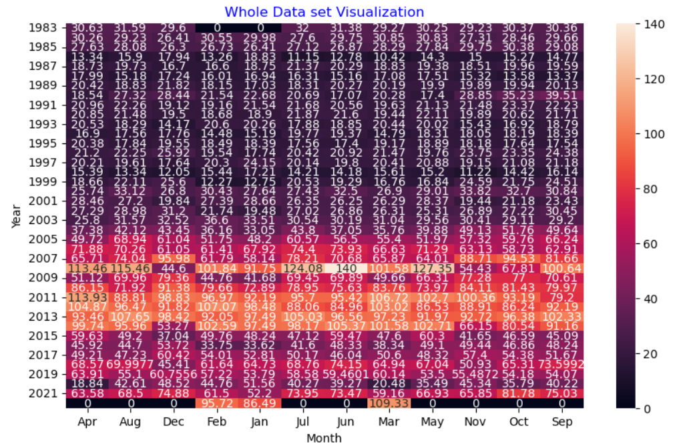
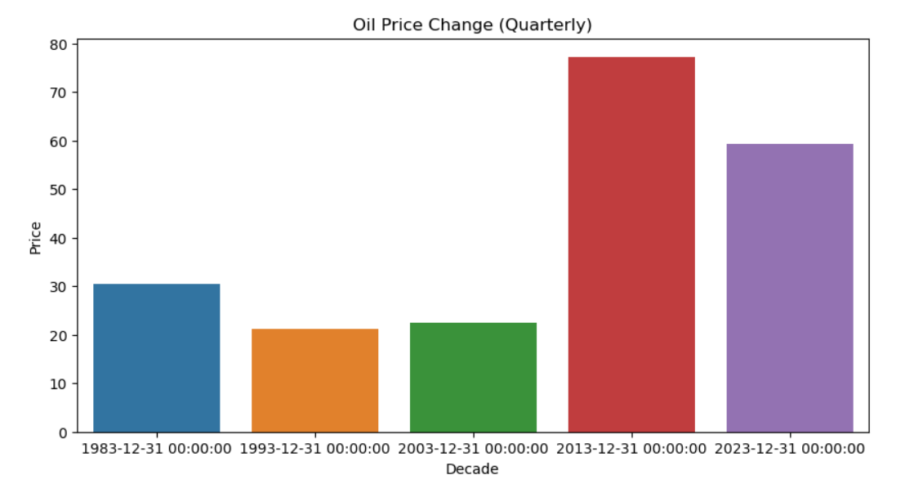
Seasonal heatmap and Decade wise plot
Oil price trend:
In the last 10 years, from 2013 to 2023, oil prices have been relatively high.
A period of low oil prices was observed from 1993 to 2003.
When analyzing monthly oil prices, a clear upward trend is evident from 2005 to 2015. During this period, prices consistently increased month by month.
However, after 2015, the upward trend in oil prices became less pronounced.

Slide 9
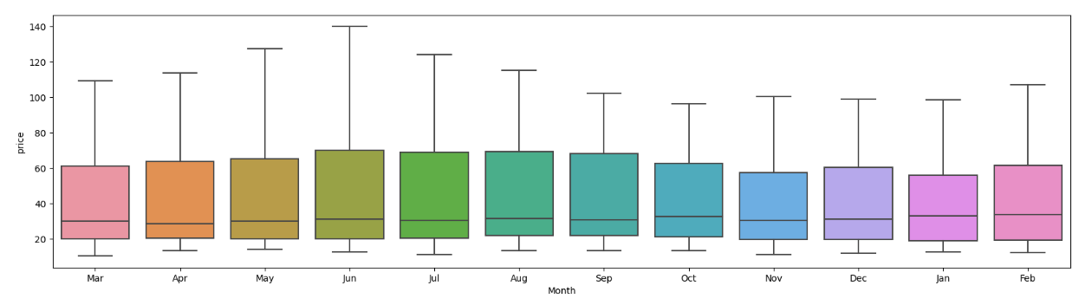
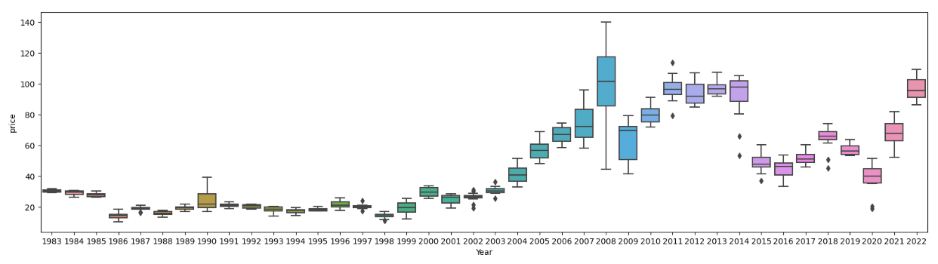
Month and Year wise Price in boxplot
When consider month wise of total data Total Jun data shows more range and Oct shows less range.
Median is almost same but upper range is highly varies

Slide 10
Feature Transformations and Stability Test

Slide 11
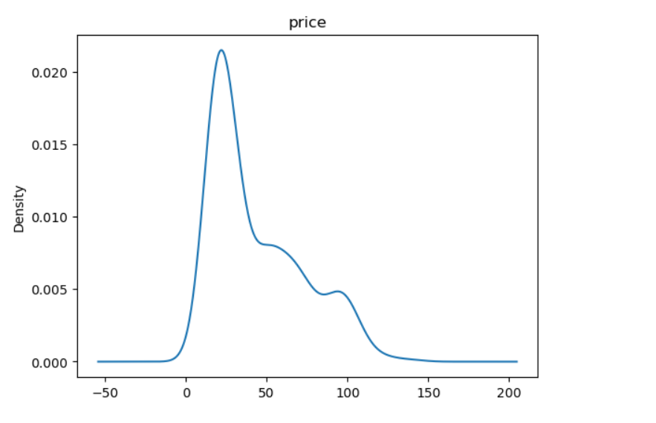
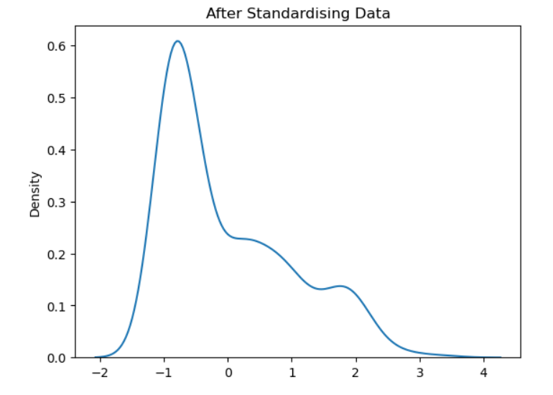
Data skewness after transformations
Actual data is right skewed so after doing standardisation also skewness could not bring to normal.

Slide 12
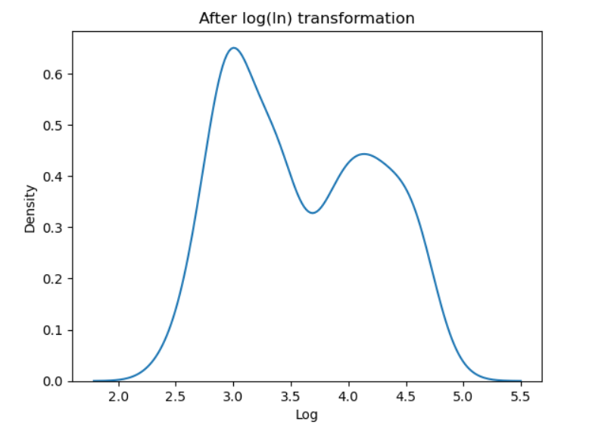
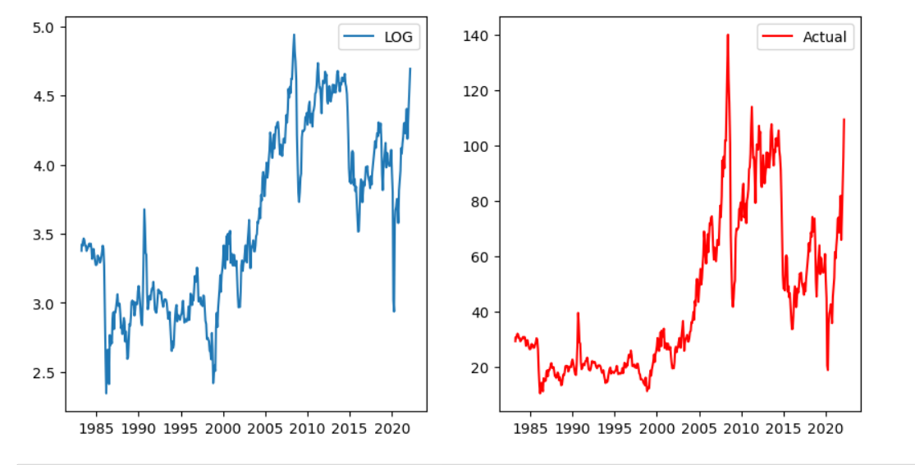
Data skewness after Log Transformations
After Log transformations skewness changed and still we will check for its stability by ADF test.

Slide 13

ADF Test
It internally does Hypothesis test
We will take Ho(Null Hypothesis) as Not stationary.
If p value higher than alpha value we will fail to reject Null hypothesis
And p < alpha then accept Alternate Hypothesis

Slide 14
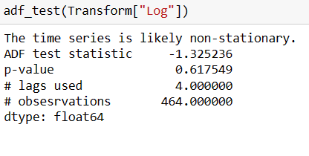
Stability after LOG transformation Using ADF test
But after ADF test its showing with data not stationary condition since p value 0.61759.
So failed to reject Null Hypothesis here since p> alpha(0.05 by default)
So log transformation not providing any stability.

Slide 15
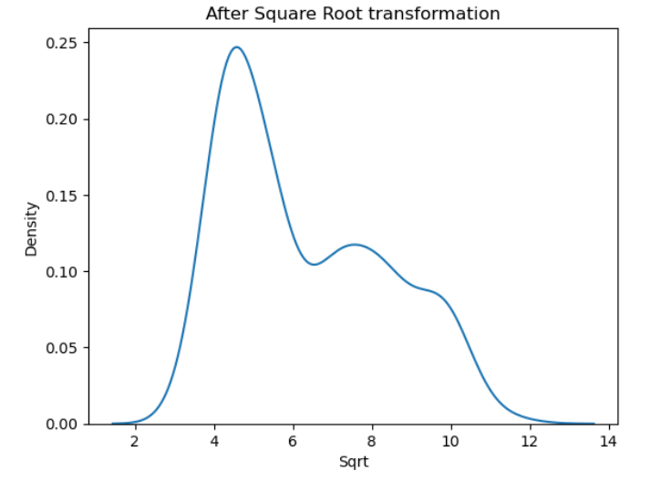
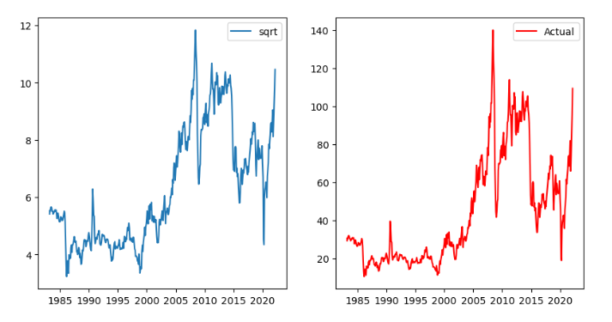
Square Root Transformation
After Square Root Transformation Skewness not Rectified

Slide 16
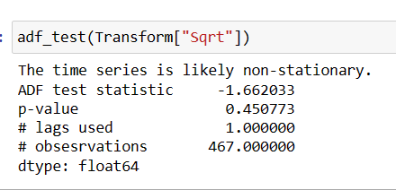
Stability Test After Square Root Transformation
Here we get p>alpha so Failed to reject null hypothesis and the data transform is not fit to provide stability

Slide 17
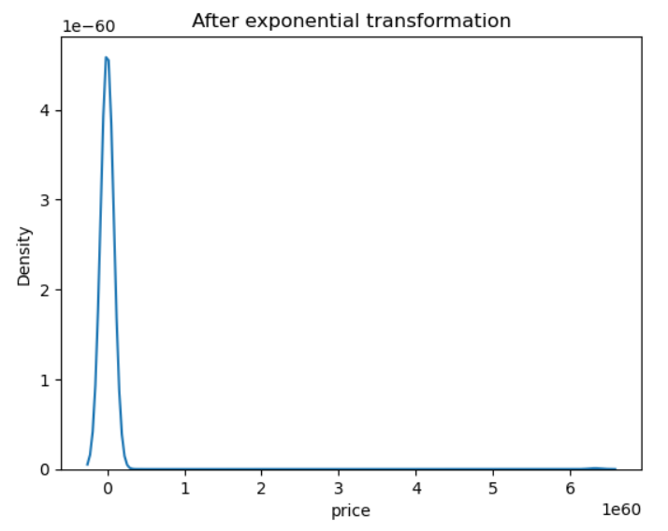
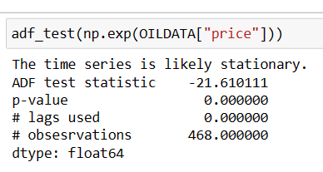
Exponential Transformation
After exponential transformation skewness reduced and got stationarity.

Slide 18
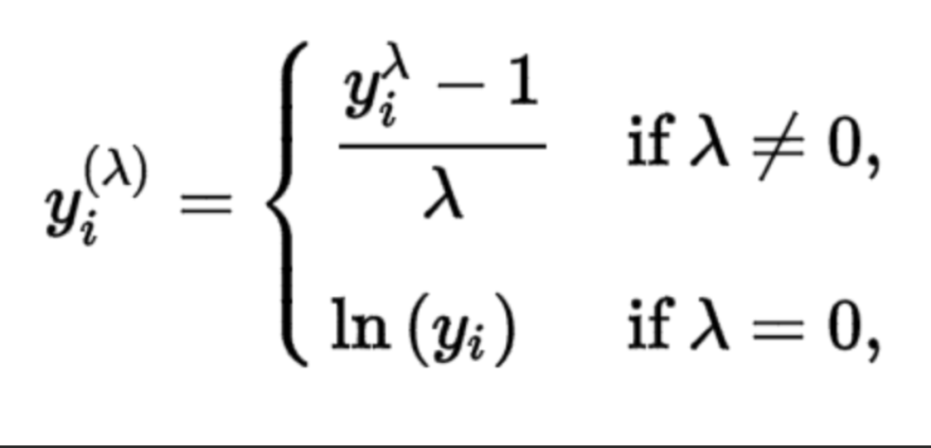
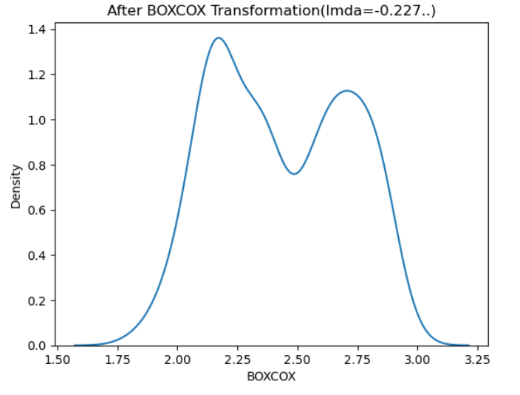
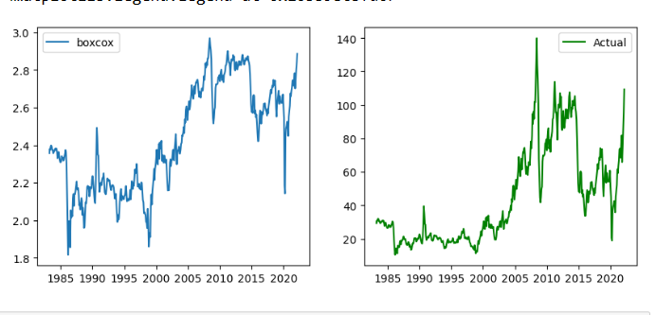
BOX COX Transformation
Here skewness reduced but not a perfect bell shaped symbol
Above is the box cox equation.

Slide 19
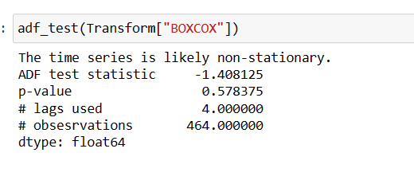
Stability After BOXCOX Transformation
Even after BOXCOX the stability not Got.

Slide 20
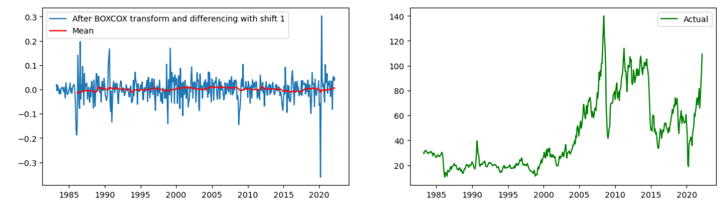
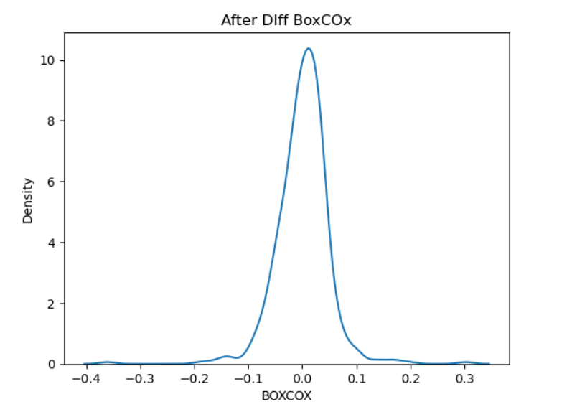
After BOXCOX Differencing
Skewness reduced after BOXCOX + DIFFERENCE WITH SIFT(1)

Slide 21
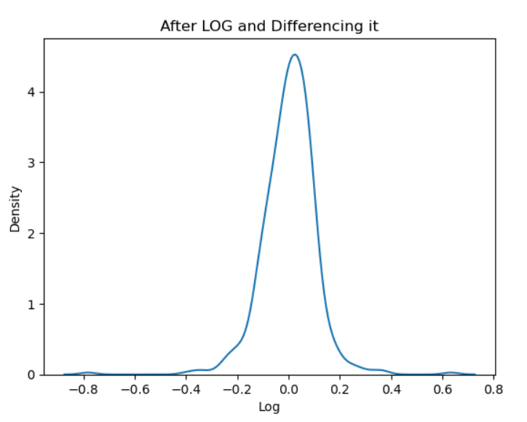
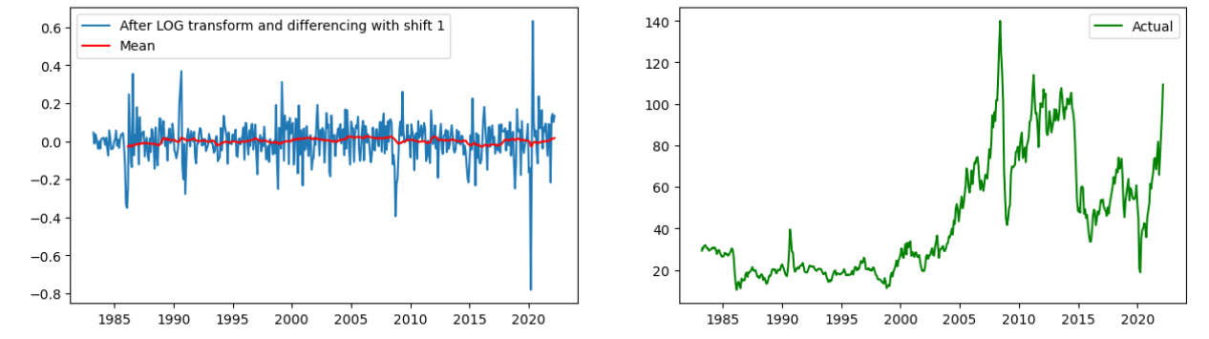
Differencing LOG Transformation
After LOG+ Differencing with shift 1 we got data without skewness.

Slide 22
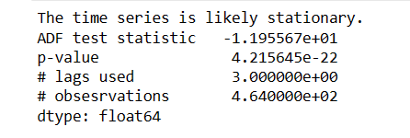
Stability after Log Differencing
Data is stationary after log differencing with shift 1 transformations with p value very less.

Slide 23
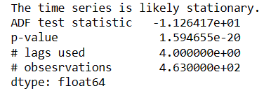
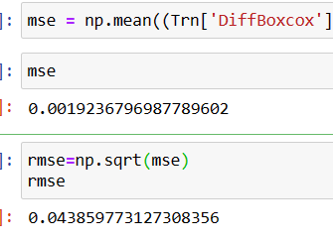
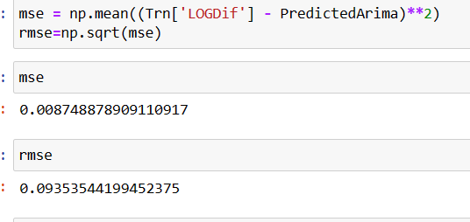
Stability after BOXCOX + Differencing
After BOXCOX and Differencing it with shift one we got perfect stability with p<<<alpha in LOG + Diff So let us build the model with LOG+ Diff Transformation.
If your data exhibits positive skewness and a long right tail, the log transformation may be preferable since it can help make the distribution more symmetric. If the distribution has more complex characteristics, the Box-Cox transformation can handle a broader range of data distributions.
MSE and RMSE LESS FOR BOXCOX DIFF. The Box-Cox transformation is a power transformation that aims to stabilize the variance of the data. It can be effective in reducing heteroscedasticity and making the data conform more closely to the assumptions of certain statistical models. However, it is important to note that the Box-Cox transformation might not always result in the lowest MSE or RMSE

Slide 24
Model Building

Slide 25
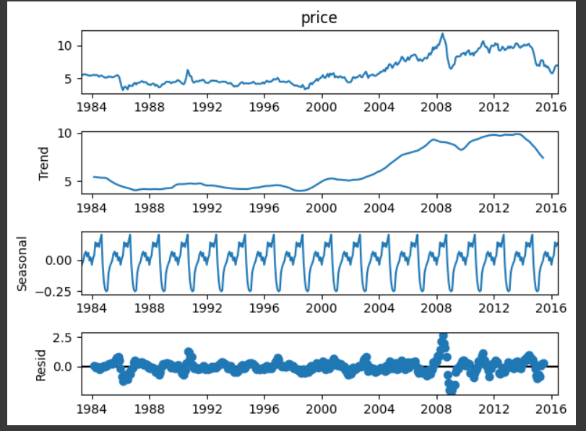
Time series Decomposition
Time series decomposition shows Trend Seasonality and residual.
It have one upward trend but its not constant.
It have the seasonality

Slide 26
Model building and Model Validation
Created model
Found RMSE
Compared RMSE of other model and compared the plot
Plot which shows more close with test data and less RMSE should be selected as final Model

Slide 27
ARIMA Models Parameters and residual check
We considered ACF , PACF plot and plot crossing +-2SE line took as order parameters for MA and AR models and used LLR (Log Likely hood Test) for order confirmation by considering model performance in each order.

Slide 28
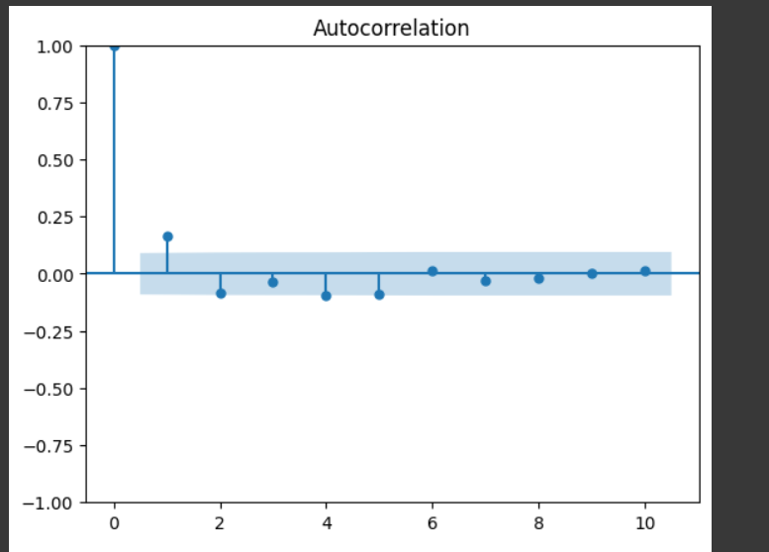
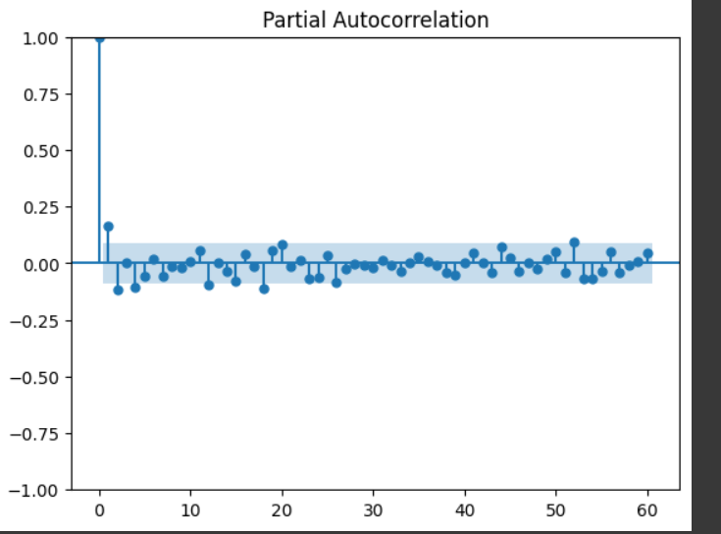
Model testing

Slide 29
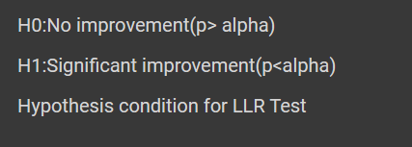
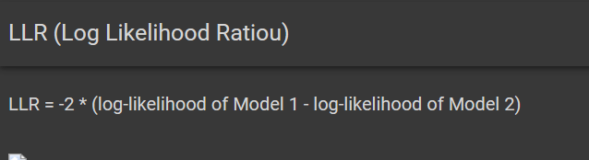
LLR Test
Each model we will change order and compare the model by using LLR test
Internally LLR Test Does a Chi square test.
And according to the p value we reject or accept the NULL-Hypothesis shown in above image

Slide 30
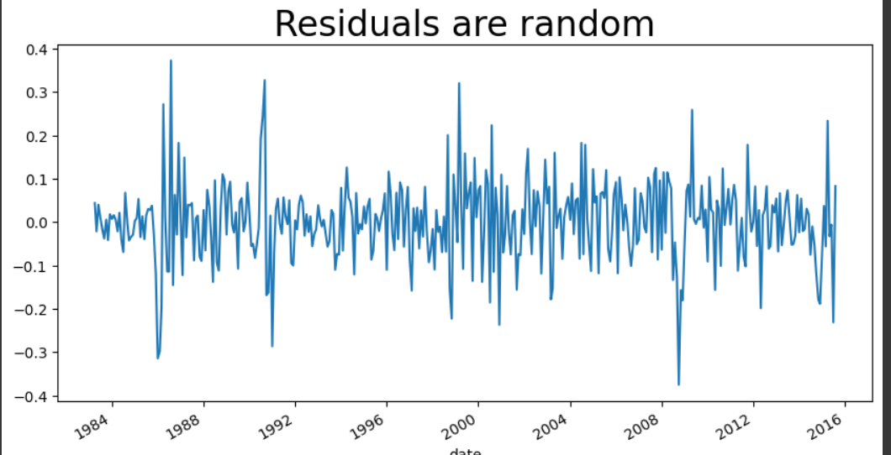
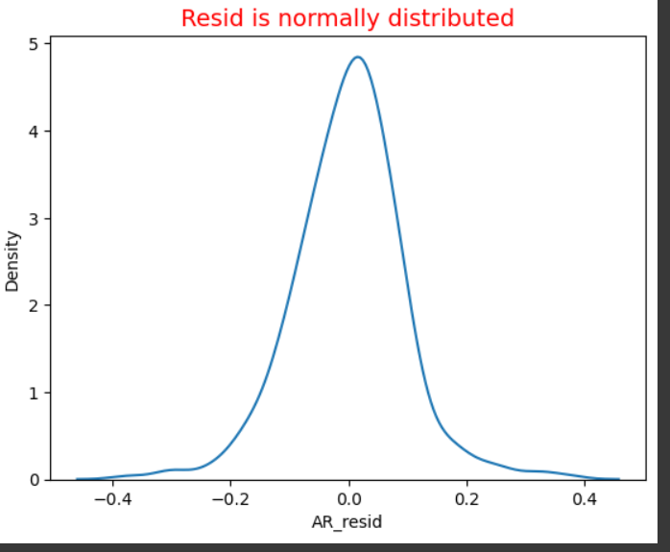
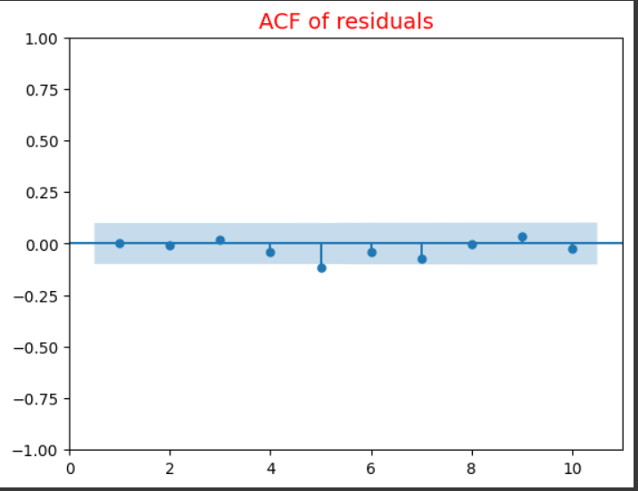
Residual Analysis
The residuals of model should be :
Mean=0
Normal Distribution
No Autocorrelation (can find by plotting ACF for Residuals of model)
Residuals should be stationary (Use ADF Test)

Slide 31
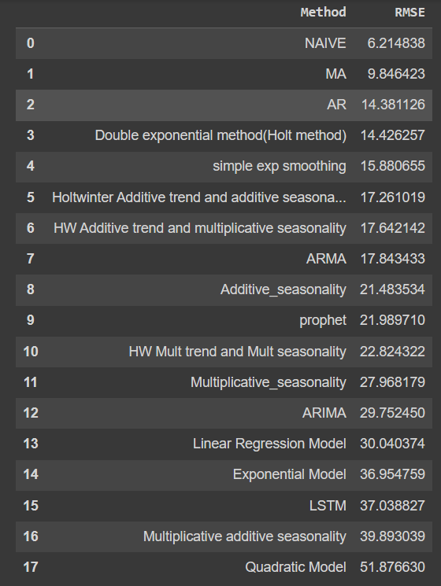
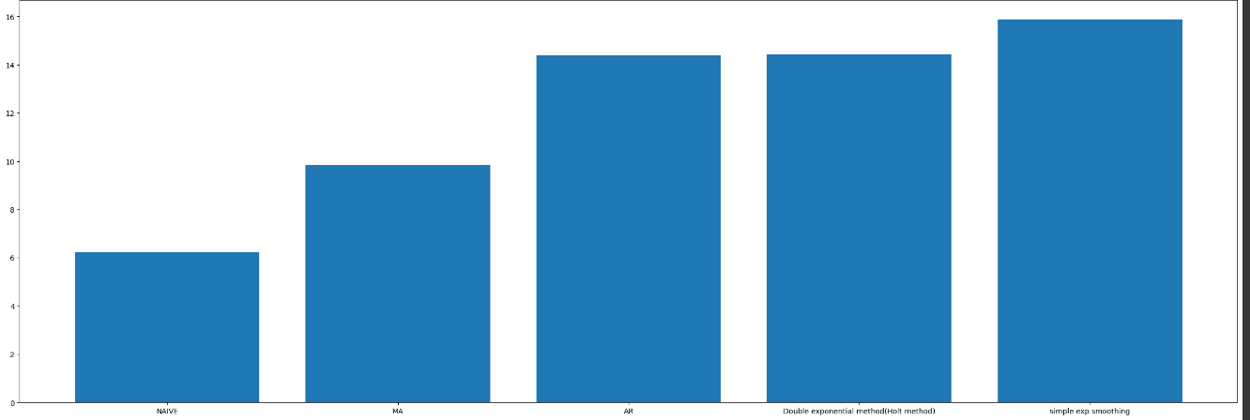
Different Model RMSE
We need to compare the forecasting plot also for model finalisation

Slide 32
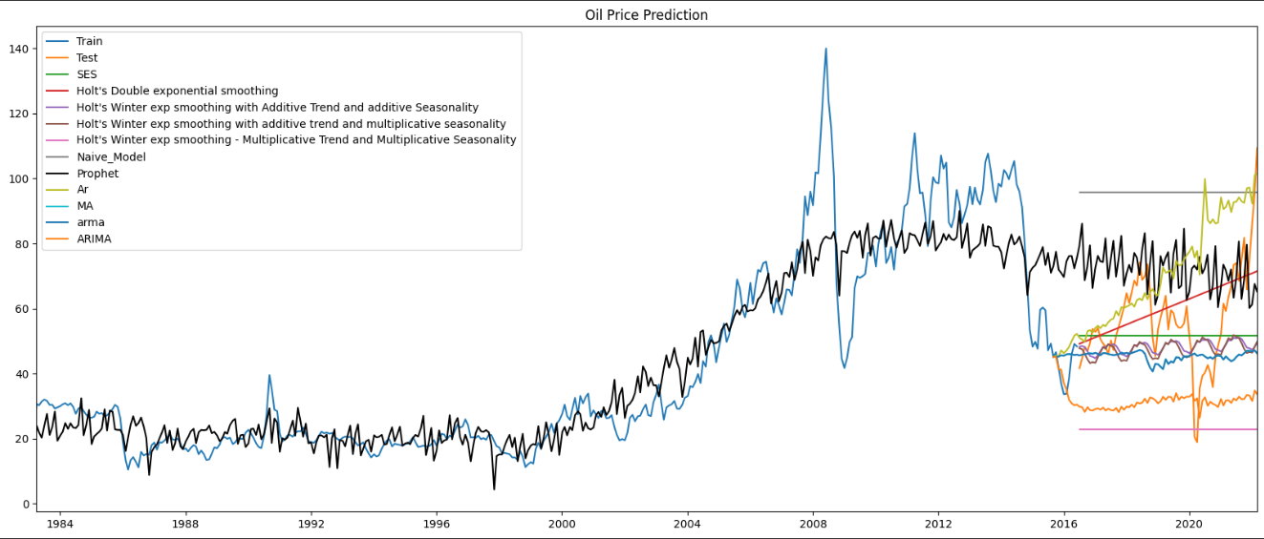
Plot of Forecasting
From above plot Prophet is showing good like HWES AS AT and HWES MS AT.
So we will ignore other methods.

Slide 33
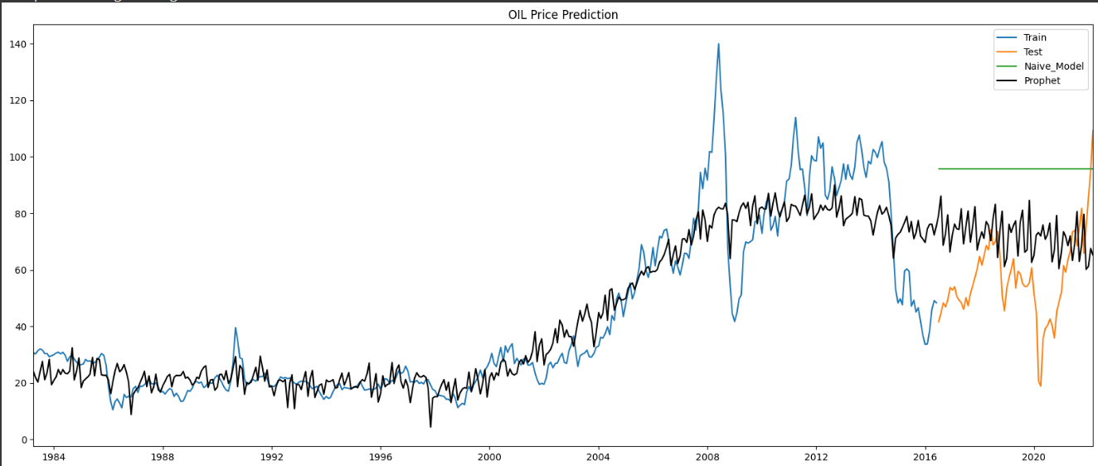
Plot of Forecasting
Naïve method shows less RMSE and its plot is some what good like prophet but since its very simple and like normal algebra algorithm using we cant take naïve for OIL price since it shows some more fluctuations So Prophet best compared to these two.

Slide 34
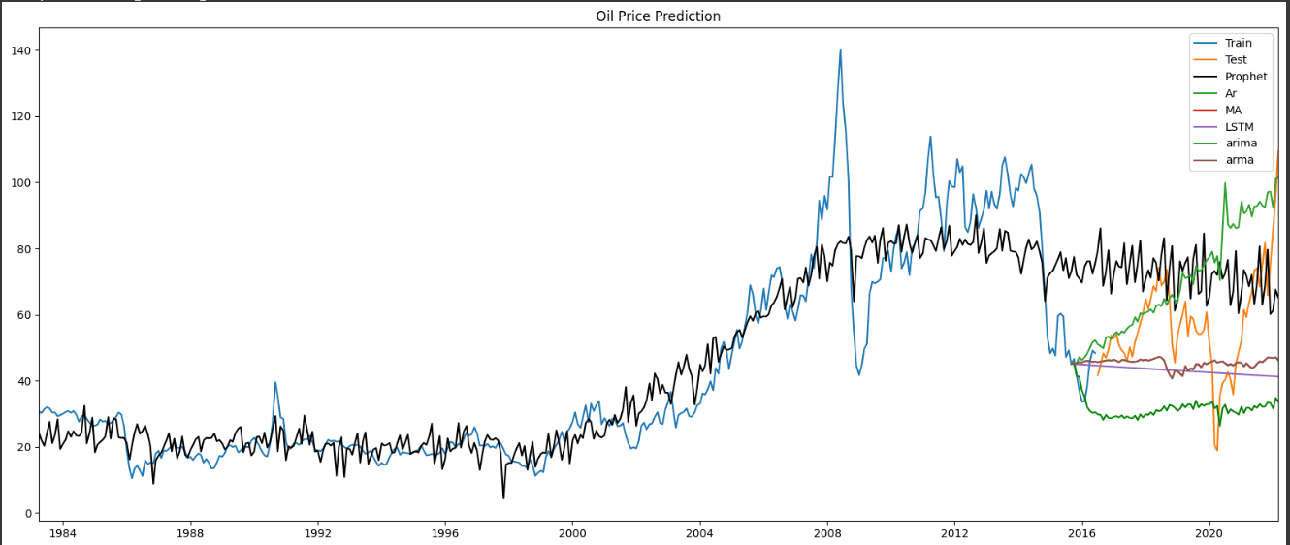
Plot of Forecasting
Prophet is best compared to other Models.

Slide 35
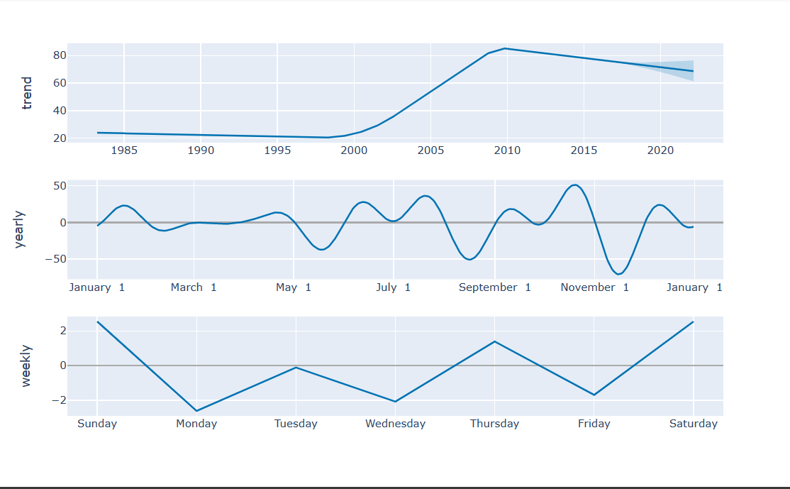
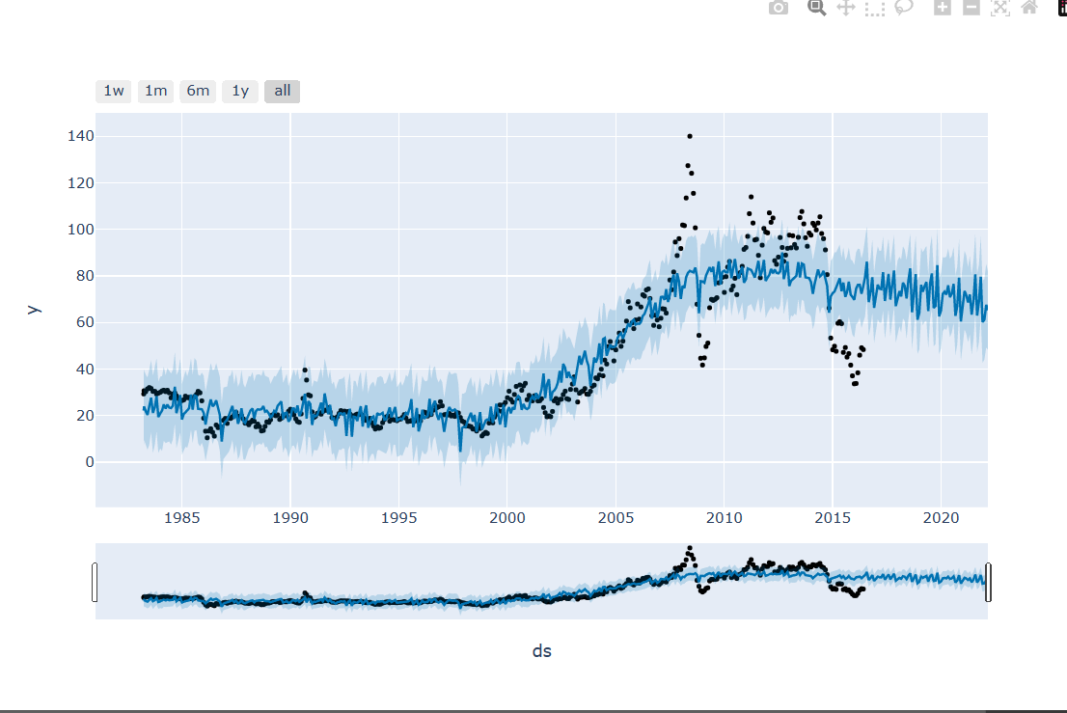
Final Model
Since prophet model have capability to deal with outliers , Holidays and not required for feature transformation since it internally does the natural log and it’s the good algorithm launched few years back and by considering its flexibility and plot graph we concluded that We will go with Prophet(Facebook).

Slide 36
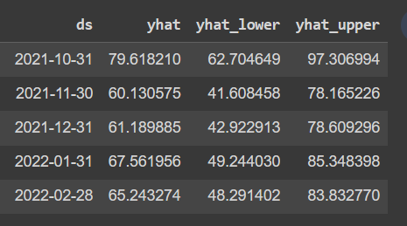
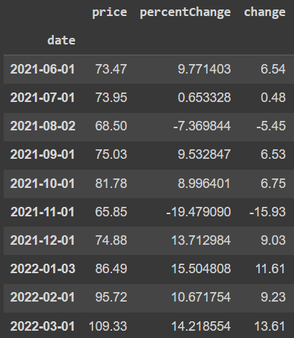
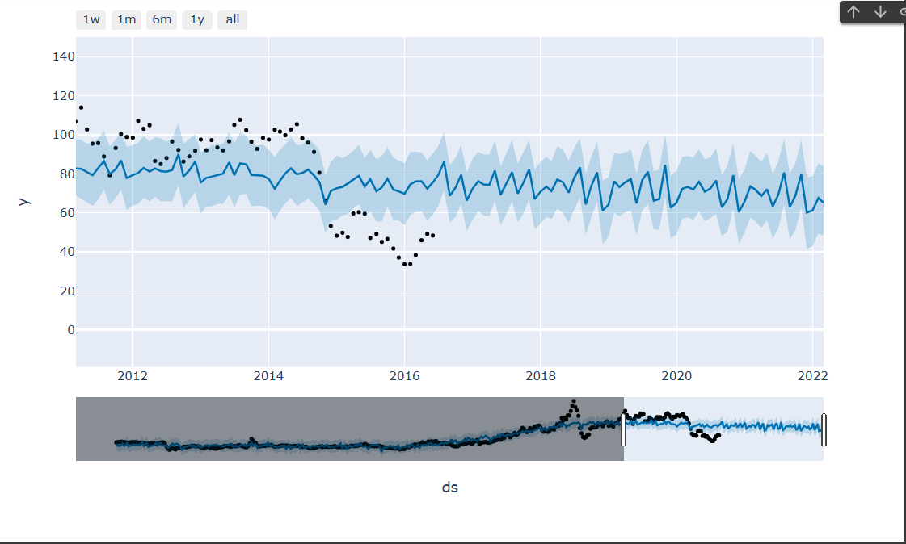
Forecasted Value Comaparison
Black dots are actual dataset
Blue line is forecasted data
The Facebook Prophet is accurate and fast.
Prophet allows adjustment of parameters and customized seasonality components which may improve the forecasts.
Prophet can also handle outliers and handles other data issues by itself.
The holiday function allows Prophet to adjust forecasting when a holiday or major event may change the forecast.
It can detect the change points automatically.

Slide 37
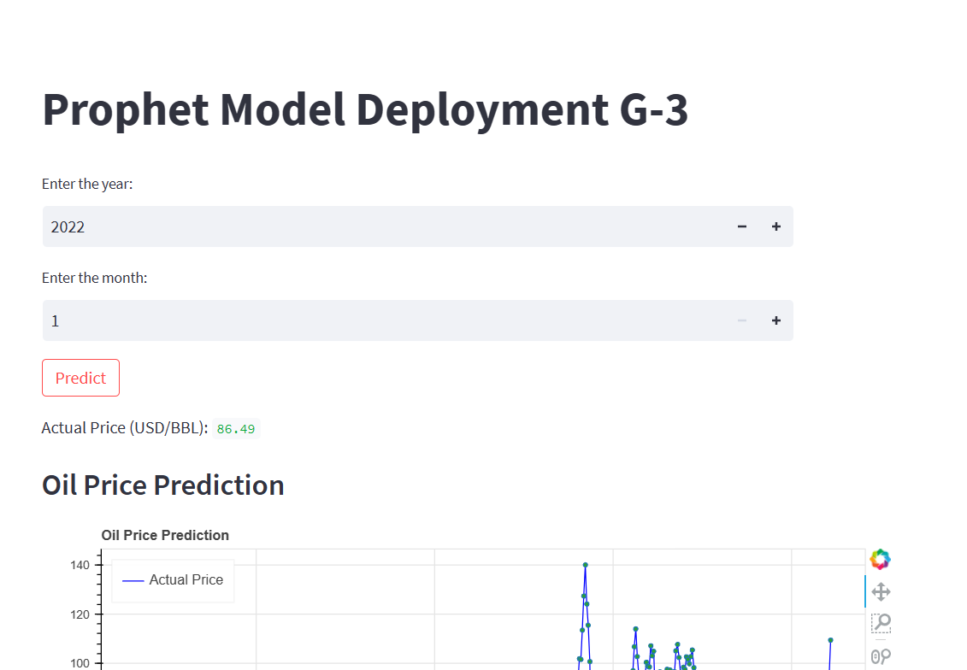

Model Deployment
Done Model Deployment using streamlit.

Slide 38
Problems Faced During Project
Sudden fluctuations in Price graph causes variation in prediction(Noise).
Data set is not Normal distributed so approached feature transformation.
Stability issues of dataset (To test it we have gone through different test ADF..)
Out Lier in dataset which could not omit since it was the part of time series.
It’s a time series and we had to convert the Date column to date time format
Data set: The data set is not contain day wise data so if day wise data also available model would have been performed well with more data.
Forecasting have lots of influencing factors which could not include in our model(Government policies, War , Natural calamities, Medical Emergencies, New Innovation in Technology, New innovations in fuel extraction…etc.)

Slide 39
THANK YOU

